Slide 1


Fifth/ Seventh Semester B.E (All branches)
Essentials of Management

Slide 2



Organizing as a function of management

Slide 3






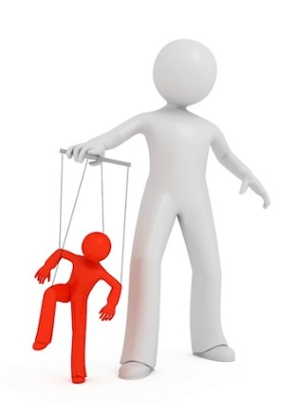





FIVE FUNCTIONS OF MANAGEMENT
1
2
3
4
5
<
Planning
It bridges the gap between where we are and where we want to be
It helps facing future with confidence
Organizing
It involves grouping of task
It involves specialisation, delegation, span of control, and departmentalization
Staffing
Hiring Right people for right job
It is devoted to acquiring, training, appraising, and compensating employees
Directing
It involves supervision, motivation, leadership, and communication
It is a very people oriented function of management
Controlling
It involves setting standards,
measuring performance as per standards, finding deviations, and taking necessary corrective action
GK

Slide 4


What is an organization?
Importance of Organizations
  Bring together resources to achieve desired goals
  Produce goods and services efficiently
  Facilitate innovation
  Use modern manufacturing and info. technologies
  Adapt to and influence a changing environment
  Create value for owners, customers and employees
  Accommodate ongoing challenges of diversity, ethics, and the motivation and coordination of employees

Slide 5

Nature and purpose of Organizing
Verifiable objectives
A clear idea of the major duties and activities involved
An understood area of discretion or authority so that the person filling the role knows that he can do to accomplish goals
  Organization implies a formalized, intentional internal structure of roles and positions.

Slide 6

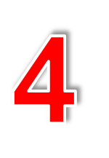
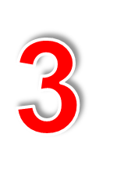









Organizing as Function of Management
Steps in Organizing Process
Building relationship between authority and responsibility
Classification of the authority
Organizing the activities
Identification of activities of the organization

Slide 7


Formal and informal organization
Formal organization means the intentional structure of roles in a formally organized enterprise.
Informal organization is a network of personal and social relations not established/required by the formal organization but arising spontaneously as people associate with one another.

Slide 8
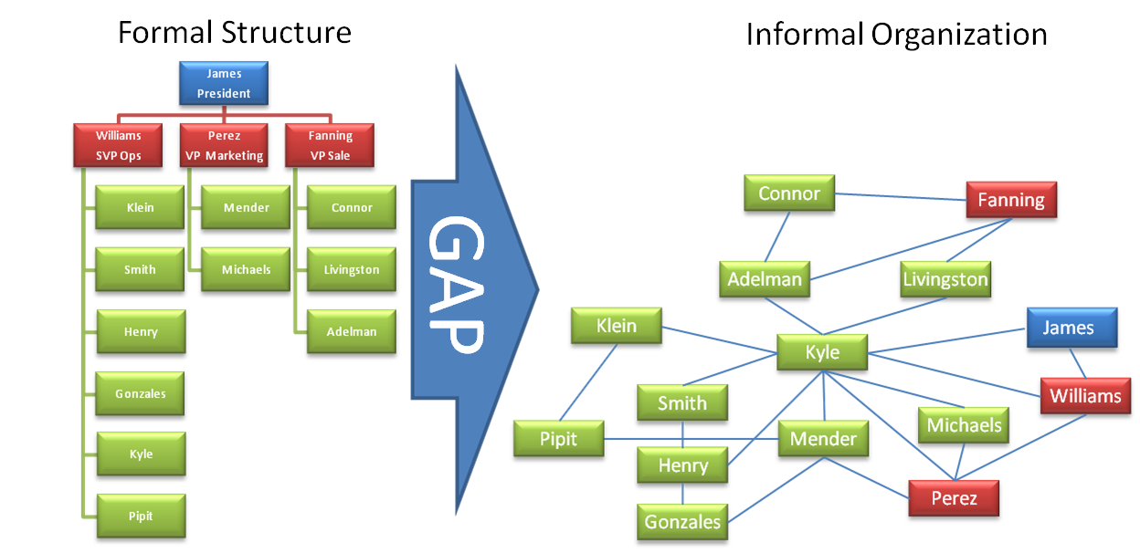
Formal and informal organization

Slide 9
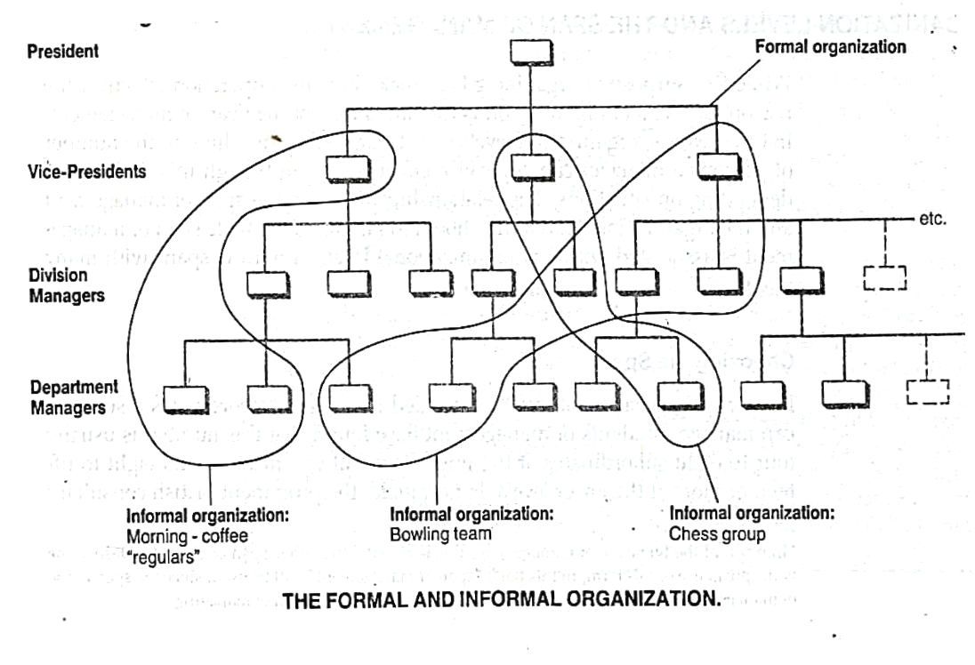
Formal and informal organization

Slide 10
Formal and informal organization
Formal organization | Informal organization
Designed and created by the top management Planned one Authority and responsibility are fixed and defined Requires an office to function Is rigid, definite, and has a written constitution | Comes up on its own Not a planned one, it is created spontaneously Authority is generally based on personal acceptance. Functions through people. Is flexible and has no such fixed Rigid, written constitution.

Slide 11
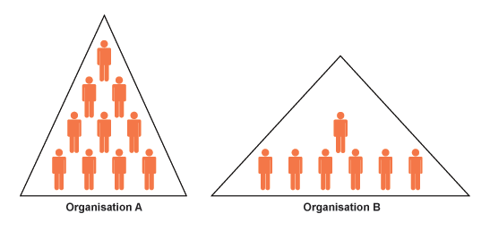
Tall and flat organizations
Tall structures have many levels of authority and narrow spans of control
Flat structures have fewer levels and wide spans of control

Slide 12
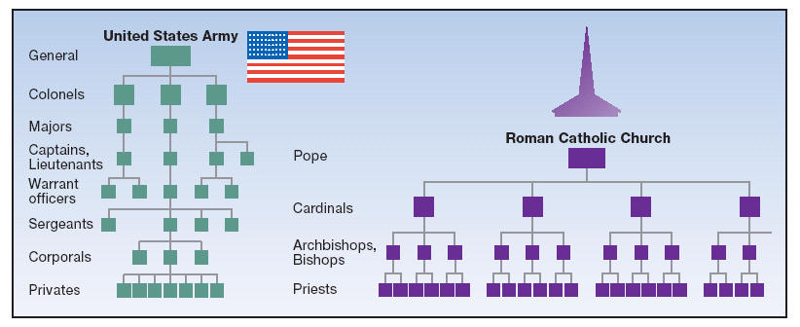
Tall and flat organizations

Slide 13

Span of control
Refers to the number of subordinates who report directly to an executive or supervisor
The differences in the span of control have direct implications on the shape of the organization
Organizations must find the optimal span of control to be effective
  Narrow enough to permit managers to maintain control over subordinates
  Wide enough so that the possibility of micromanaging (interfering) is minimized

Slide 14
Factors effecting span of control
The optimal span of control is dependent on the following factors
  Subordinates training: Well trained subordinate requires less time of supervisor. In this case a broader span is feasible
  Delegation of authority: If manager clearly delegates the authority, then a subordinate can get it done with a minimum superiors time and attention.
  Planning: Clear policies to guide decisions for the subordinates result in fewer dependencies on superiors time
  Rate of change: Dynamic industry calls for narrow span, if stable business, broader span

Slide 15
Factors effecting span of control
The optimal span of control is dependent on the following factors
  Communication techniques: Broader span is feasible if the manager can communicate effectively.
  Kind of activity: If the activities are highly important and complicated, then small span is recommended.
  Kind of organization: Centralized organization requires narrow span. Decentralized organization decisions are made at lower level and there is freedom of action.
  Organizational level: If delegation of authority done at lower level, then we can have a wider span of control.

Slide 16
Principles of organizing (Urwick)
Principle of unity of objectives
An organization structure is effective if it enables individuals to contribute to enterprise objectives.
2. Principle of organizational efficiency
An organization is efficient if it is structured to aid the accomplishment of enterprise objectives with a minimum of unsought consequences or costs.
3. Principle of specialization
The whole work should be divided amongst the subordinates on the basis of qualifications, abilities, and skills.

Slide 17
Principles of organizing (Urwick)
4. Span of management
The number of persons an individual can efficiently and effectively manage is referred to as the span of management. There is a limit to this number. The exact number will depend on the impact of underlying variables.
5. Principle of scalar chain
A scalar chain is a chain of command or authority that flows from upper organizational level to the lowest levels and clarifies who reports to whom.
6. Principle of unity of command
Every subordinate is answerable and accountable to one boss at one time.

Slide 18
Principles of organizing (Urwick)
7. Principle of delegation
The authority must be delegated as far down in the organization as possible. Adequate authority should be delegated to all individuals so that they accomplish the results expected.
8. Principle of parity of authority and responsibility
The responsibility for actions cannot be greater than that implied by the authority delegated, nor should it be less.
The responsibility of subordinates to their superiors for performance is absolute, and superiors can't escape responsibility for the organizational activities of their subordinates.

Slide 19
Principles of organizing (Urwick)
9. Principle of flexibility
The organizational structure. must be simple to understand and flexible.
The structure should be adaptable to the changes in the nature of business and technology and procedures.
10. Principle of functional definition
Every position in an organization and every department in an organization must have a clear definition of the results expected, activities to be undertaken and authority delegated.

Slide 20
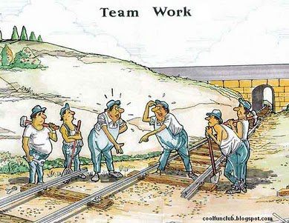
Any Questions ???

